Slide 1

Divergence Academy Attendance

Slide 2
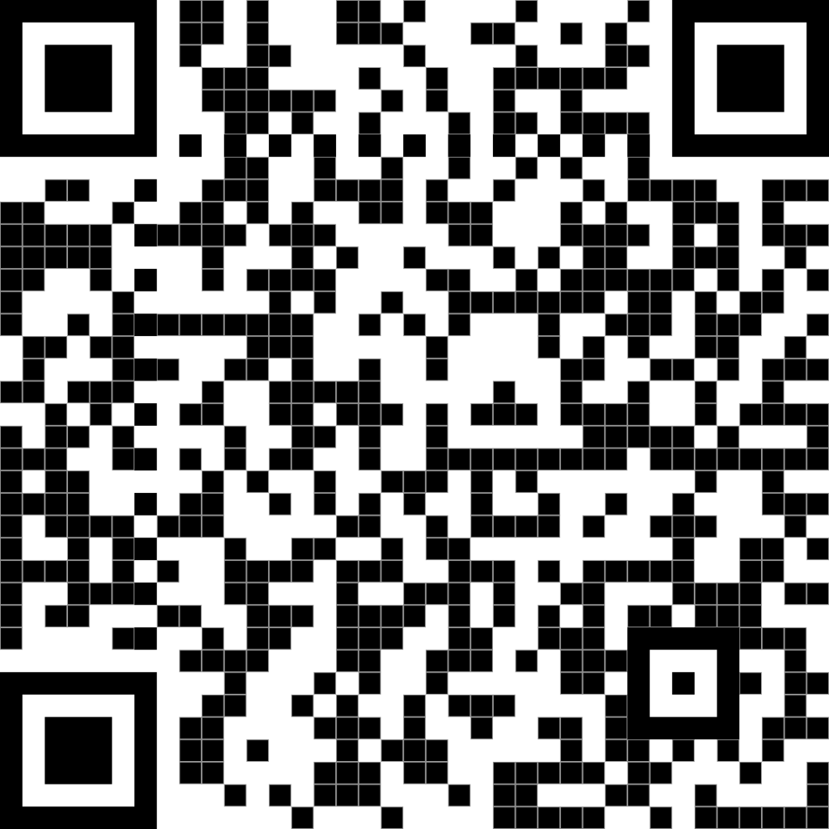
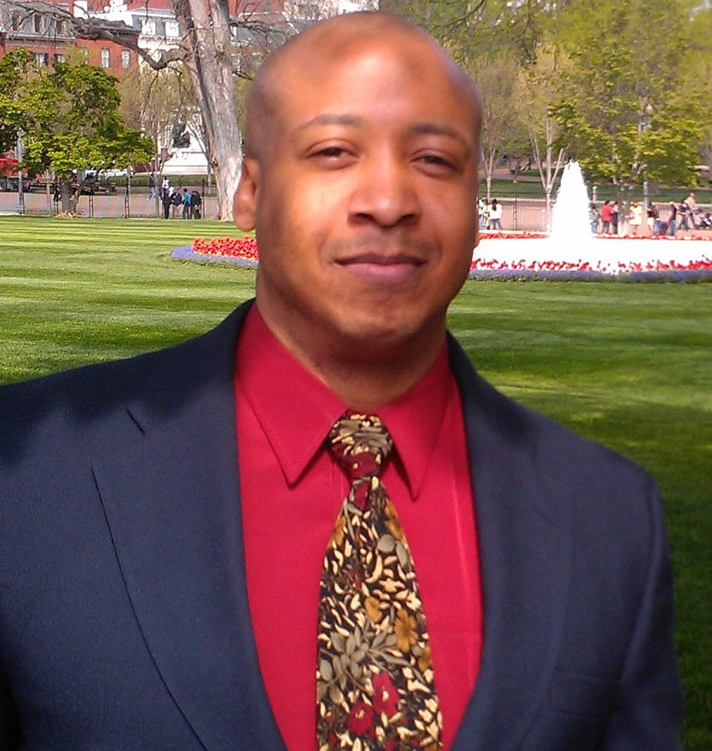
About Me
Experience
Retired Army Signal Officer
Former Microsoft ITSM Consultant
Education
MSCS , Colorado Technical University
BA Sociology, University of New Mexico
Korean Linguist, Defense Language Institute
Certifications
ITIL v3 Expert
Certified Knowledge Manager

Slide 3

Problem Statement
Although Divergence Academy provides a variety of high-tech immersive courses using some of the latest technology in the industry, attendance for on-site students is paper based

Slide 4
Business Value Proposition
Modernize
Modernize the process
Reduce
Reduce administrative man-hours
Improve
Improve school brand and reputation

Slide 5
Proposed Solution
SharePoint – Data Storage for the App
Power App – Divergence Academy Attendance
Power Automate – Connect App to SharePoint
Power BI – Attendance Related Visuals

Slide 6
SharePoint Capstone App TeamSite
Student Cohorts
Student Registration
Student Attendance

Slide 7
Power App: Divergence Academy Attendance
Registration Screen
Check-In Screen
Thank You Screen

Slide 8
Power Automate
Registration Flow
Attendance Flow

Slide 9
Power BI
SharePoint Dataset
Attendance Related Measures
Gauge Visual

Slide 10
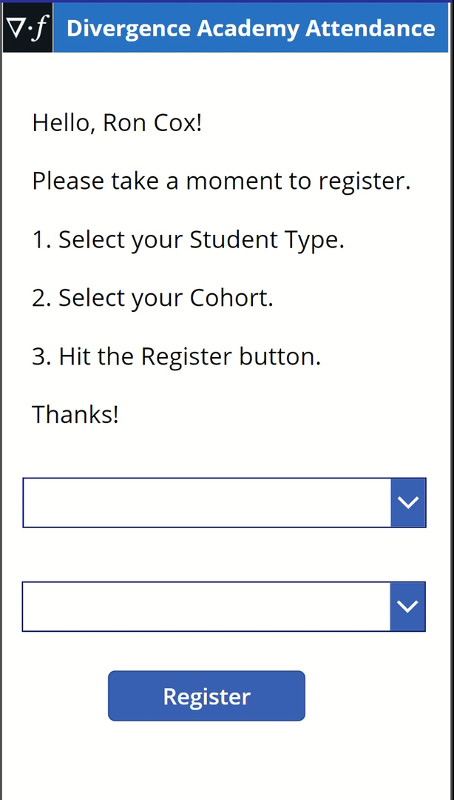
Demo: Registration

Slide 11
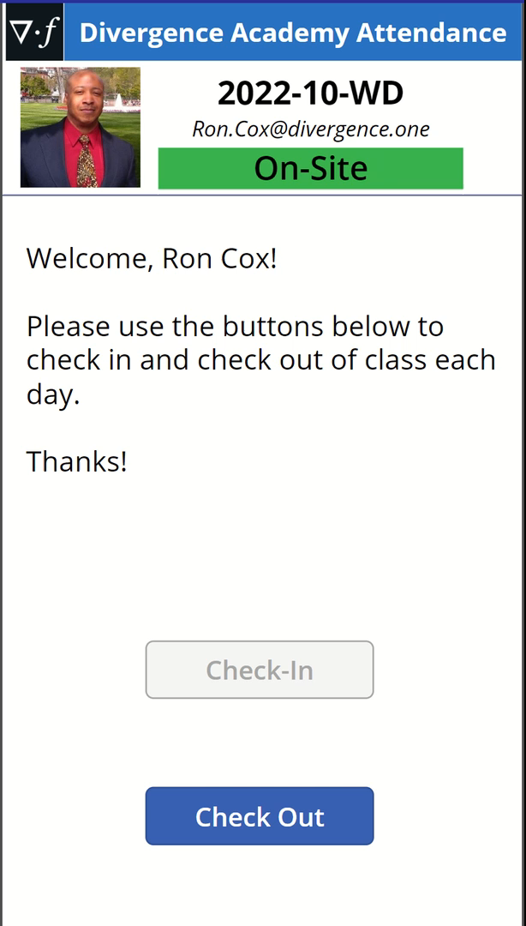
Demo: Check-In/out

Slide 12
Post Implementation Review
Process Owner: Student Attendance
Stakeholder Interviews
Cohort List
Holiday List
SharePoint User List
Integrate Microsoft Teams Participant Reports
Biggest Challenge: Power BI Integration

